Slide 1
PROJECT- I
HEART DISEASE PREDICTION
SEMESTER : 5
CLASS : TY BTECH
BRANCH : CSE-AIML

Slide 2
PROJECT TEAM
Roll No. | Names
17 | Bhagyashree M. Swami
09 | Rohit V. Chitari
14 | Aniket C. More
15 | Prathmesh S. Suryavanshi

Slide 3
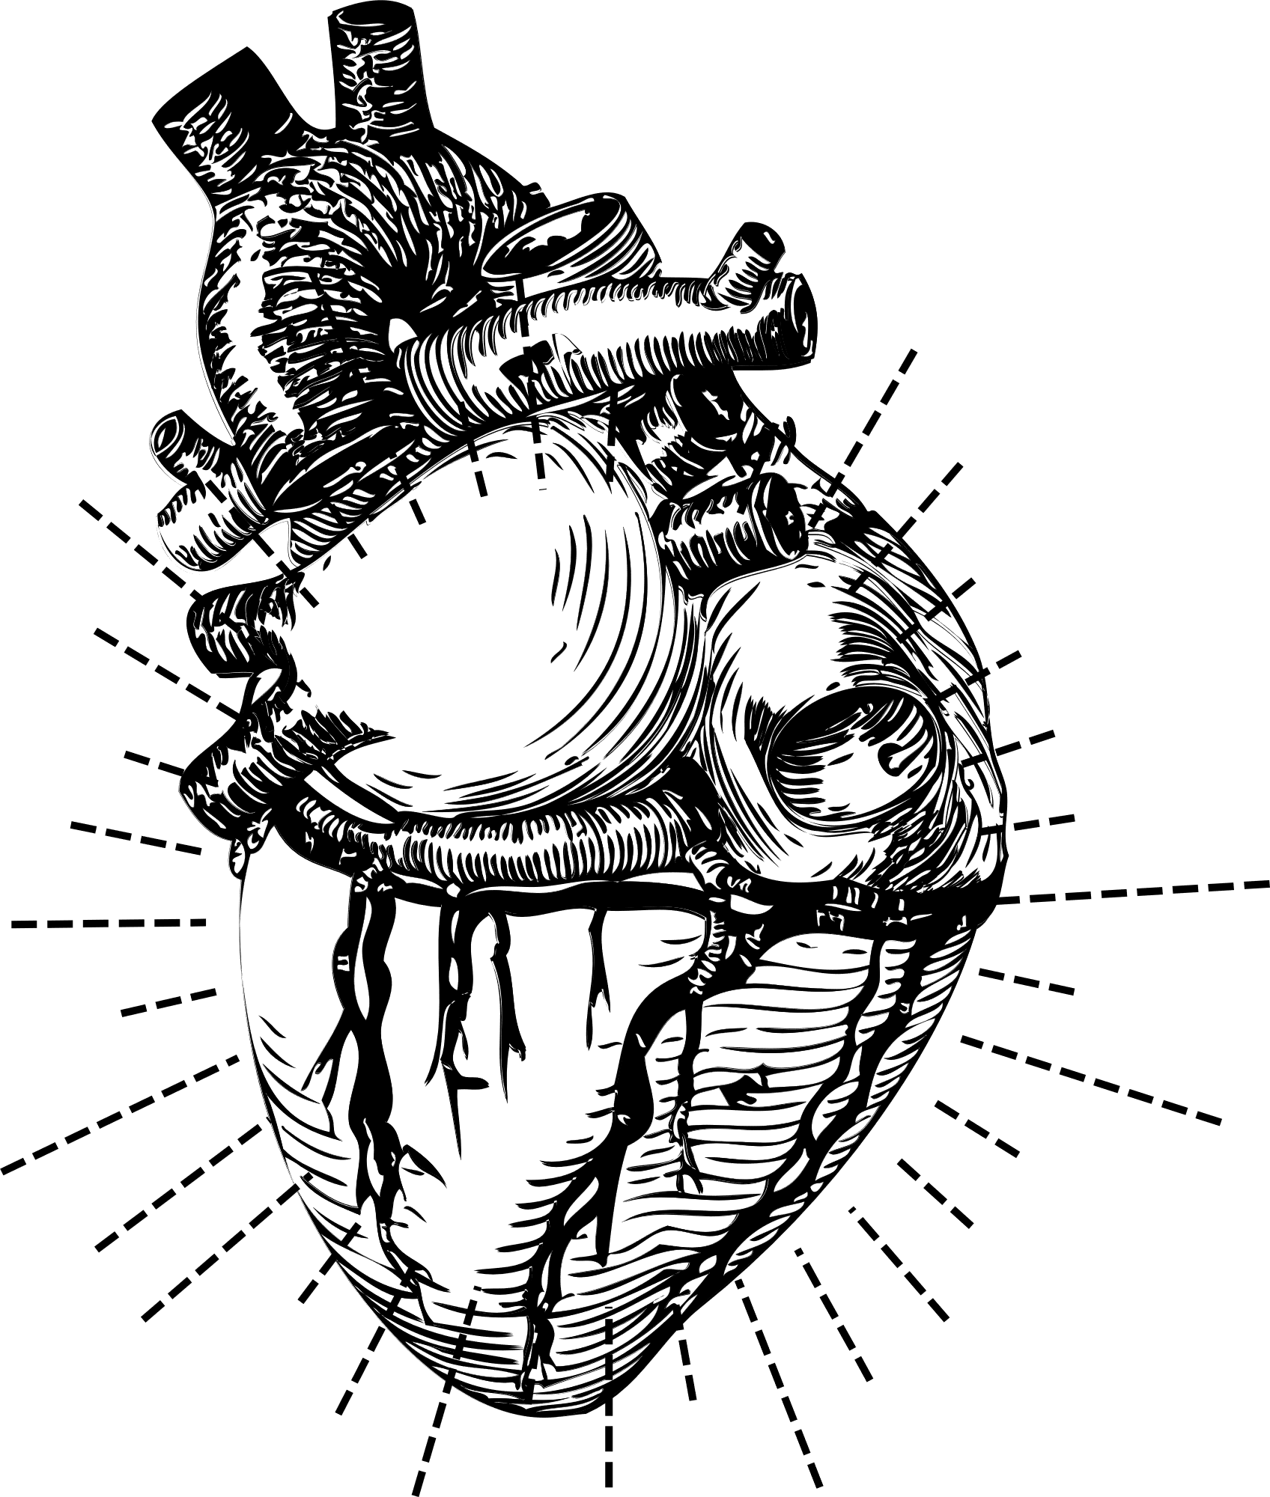
WHAT WE'LL DISCUSS TODAY
Outline
Problem Statement
Objective
Designed System Architecture
System Flowchart
Dataset Details
Tools & methods
Requirements
Result Analysis
Conclusion

Slide 4
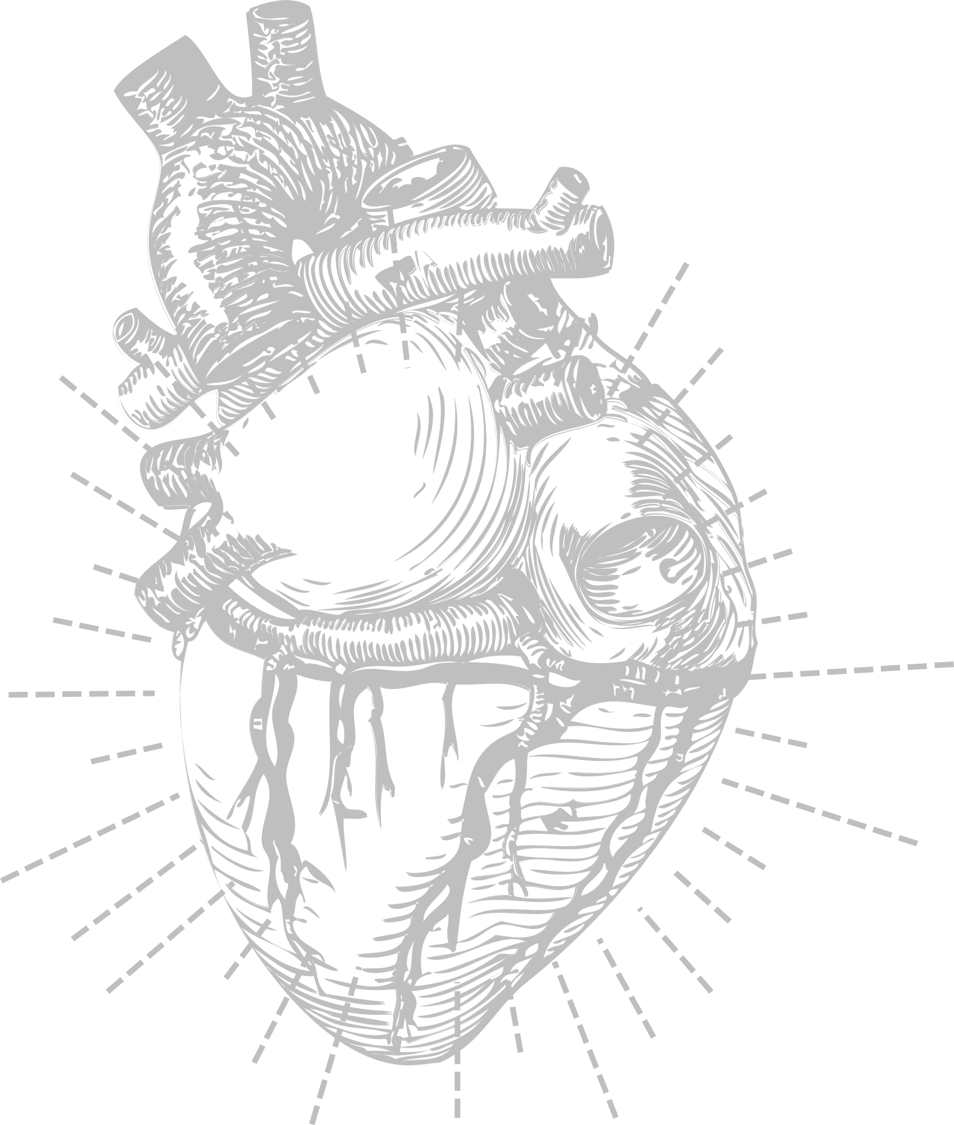
LET'S GET
STARTED

Slide 5
Problem Statement
The problem statement involves developing a real-time heart disease prediction model for timely identification of cardiovascular risks. This entails creating an accurate and scalable machine learning system that analyzes diverse health data, prioritizes relevant features, and integrates seamlessly into healthcare workflows.
The goal is to provide healthcare professionals with a reliable tool for early detection and intervention in cardiovascular diseases.

Slide 6

OBJECTIVES
Objective Of Study
1. For Early Detection
2. To Preventive Interventions
3. To Reduced Burden on Healthcare System
4. To get Personalized Medicine
5. To Improve Patient Outcomes
6. For Real-time Prediction and Deployment
7. To Research and Insights

Slide 7
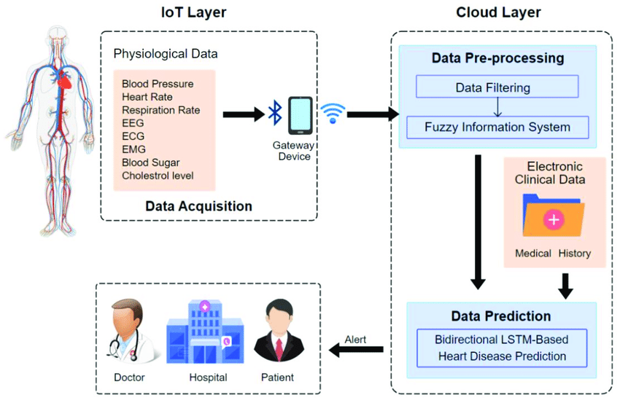
Designed System Architecture / Flow Chart

Slide 8
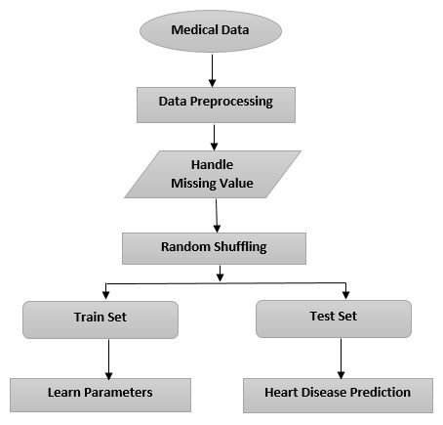
SYSTEM ARCHITECTURE

Slide 9
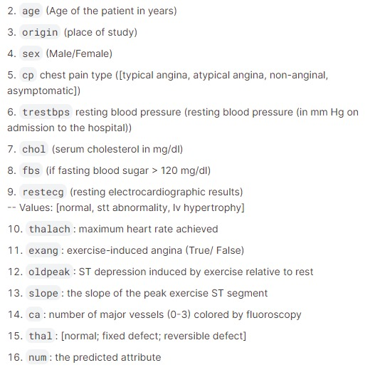
DATASET DETAILS
Heart Disease Prediction Model’s Dataset
Target : Heart Disease Is present or Not (Yes:1 , No: 0)

Slide 10

TOOLS & METHODS
Tools
Programming Languages:
Python
Machine Learning Libraries:
Scikit-Learn
Data Visualization:
Matplotlib
Seaborn

Slide 11

TOOLS & METHODS
Methods
1. Data Preprocessing
Data Cleaning
Data Wrangling
2.Feature Selection
3.Machine Learning Algorithms:
Logistic Regression
Random Forests
Support Vector Machines (SVM)
K-Nearest Neighbors (KNN)
Decision Tree
4.Model Evaluation

Slide 12
REQUIREMENTS
H/W Requirements
S/W Requirements
Processor: Intel core i5
RAM: 8 GB
ROM: 256 GB
OS: Windows OS
Programming Lang: Python
Jupyter notebook

Slide 13
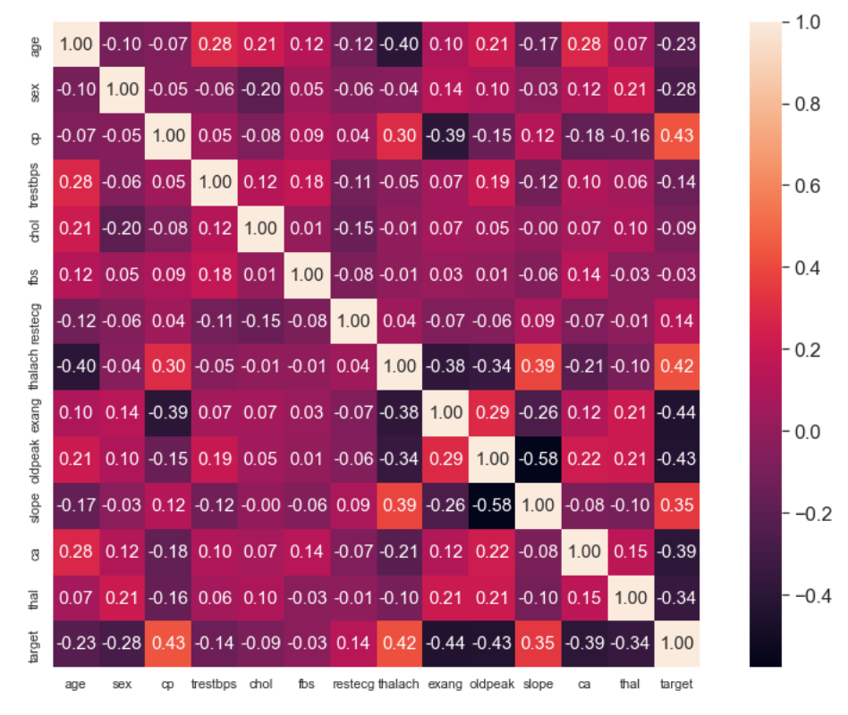
Display of Relation between Features by heatmap

Slide 14
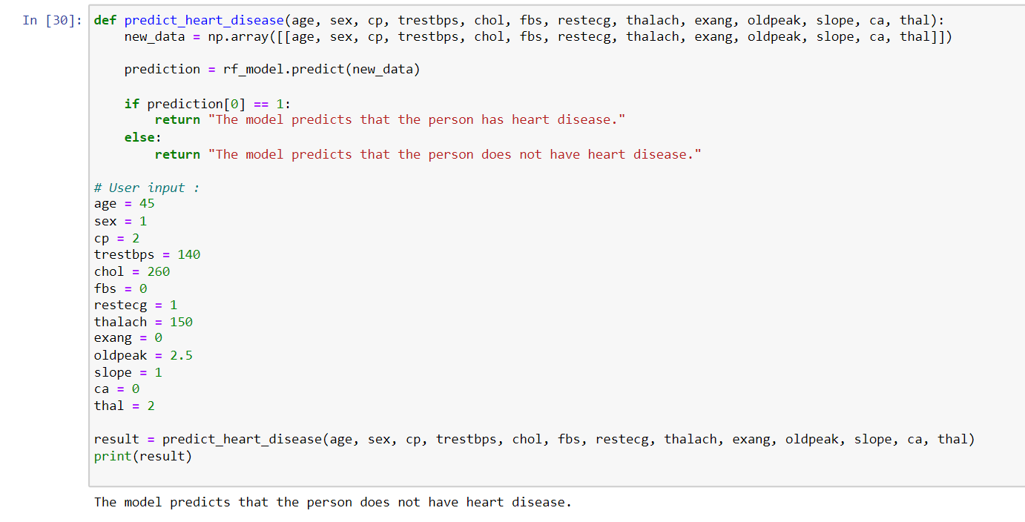
Model Prediction on Test Data Set

Slide 15
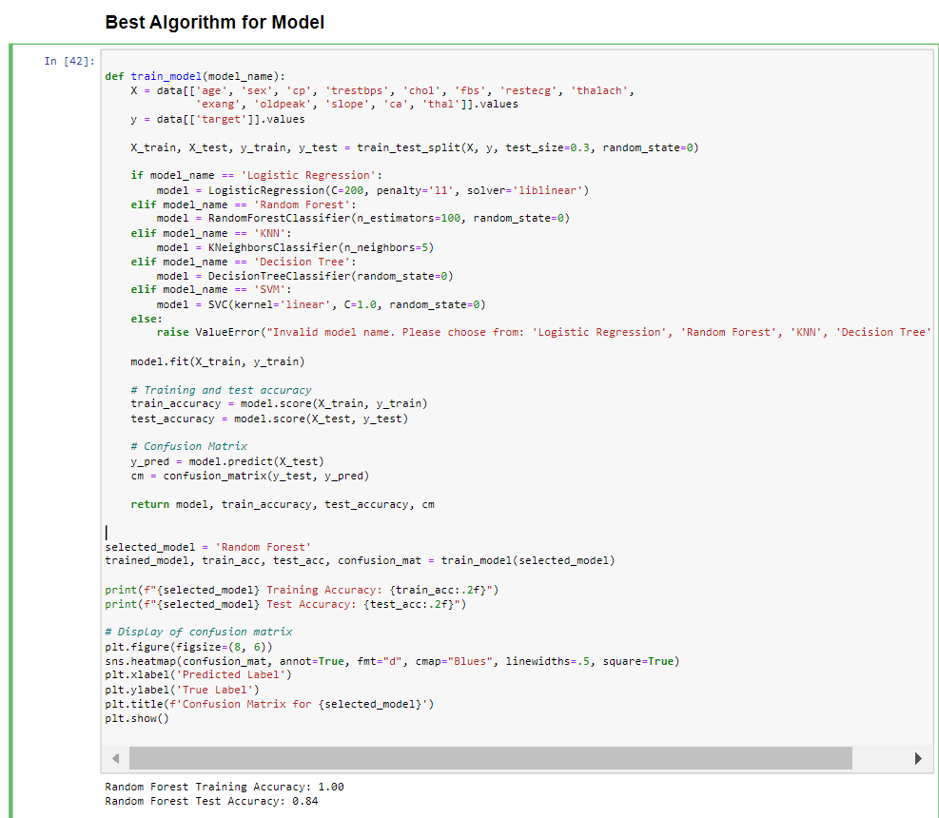

Slide 16
CONCLUSION
In conclusion, learning machine learning techniques for Heart disease prediction represents a significant advancement in healthcare. Through the analysis of diverse datasets and the application of sophisticated algorithms, these predictive models offer valuable insights and numerous benefits.
Machine learning models provide valuable feedback loops for continuous improvement. By analyzing outcomes and refining algorithms, researchers and healthcare providers can enhance the accuracy and effectiveness of predictive models over time. This iterative process drives.

Slide 17
REFERANCES
S. Ouyang, "Research of Heart Disease Prediction Based on Machine Learning," 2022 5th International Conference on Advanced Electronic Materials, Computers and Software Engineering (AEMCSE), Wuhan, China, 2022, pp. 315-319, doi:10.1109/AEMCSE55572.2022.00071. https://ieeexplore.ieee.org/abstract/document/9948280/
Soni, Jyoti, Ujma Ansari, Dipesh Sharma, and Sunita Soni. "Predictive data mining for medical diagnosis: An overview of heart disease prediction." International
Journal of Computer Applications 17, no. 8 (2011): 43-48. https://www.academia.edu/download/79534142/5a18f6653b56138cd5196d20e2f39de 189e3.pdf
“HEART DISEASE PREDICTION SYSTEM” Mrs.Jayashree L K, Sushmita Makapur, T D Vyshnavi, T D Prathyusha, V K Kavya http://www.irjcs.com/
External Links:
https://www.researchgate.net/ https://towardsdatascience.com/ https://scholar.google.com/

Slide 18

THANKS !!
FOR YOUR KIND ATTENTION !!

